Slide 1
GO TEAM MEETING #1
Mary Lin Elementary School
September 26, 2023

Slide 3
Timeline for GO Teams
You are HERE
1
2
3
4
5
Fall 2021
GO Team Developed 2021-2025 Strategic Plan
Summer
School Leadership completed Needs Assessment and defined overarching needs for SY22-23
August
School Leadership completed 2022-2023 Continuous Improvement Plan
Sept. – Dec.
Utilizing current data, the GO Team will review & possibly update the school strategic priorities and plan
Before Winter Break
GO Team will take action (vote) on the rank of the strategic plan priorities for SY23-24 in preparation for budget discussions.

Slide 4
TOPICS
School Strategic Plan
Strategic Plan & Priorities Review
SMART Goals
Data Discussion
Spring MAPS
GA Milestones (GMAS)
Principal’s Report
Current Enrollment & Leveling
Information about our school

Slide 5
CURRENT STRATEGIC PLAN
2021-2025

Slide 6
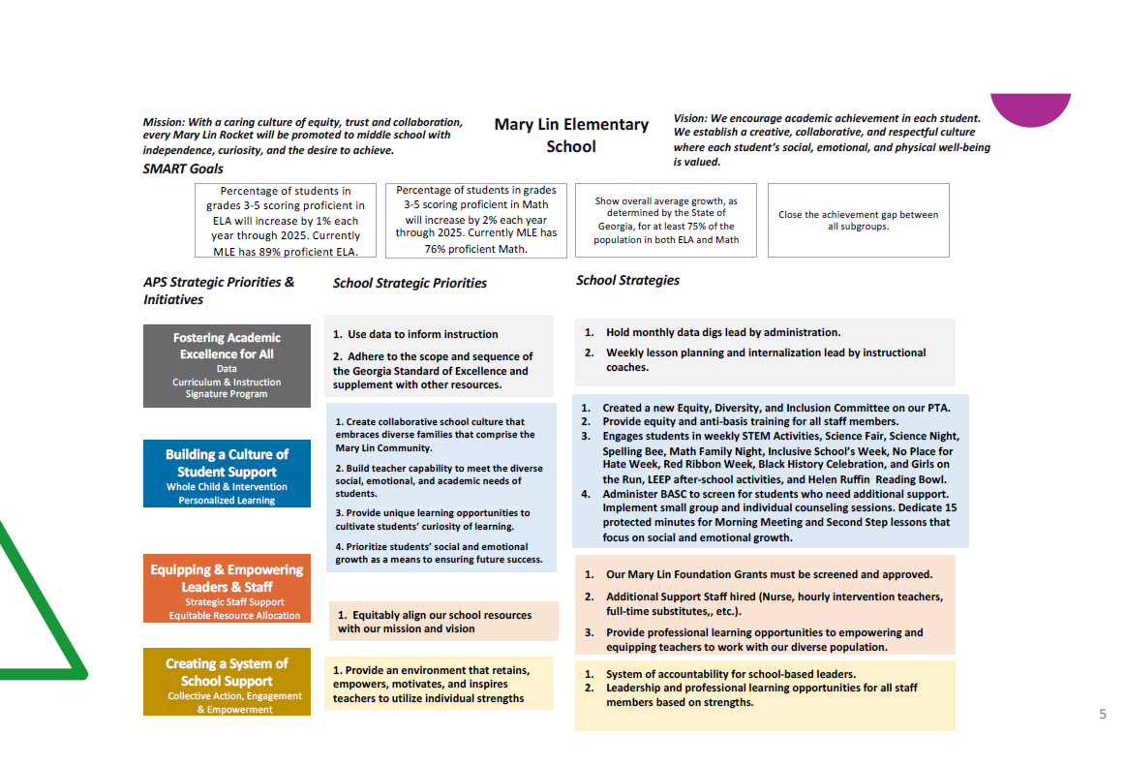

Slide 7
Strategic Plan
Priority Ranking
Mary Lin ES GO Team approved January 25, 2023
Higher
Build teacher capability to meet the diverse social, emotional, and academic needs of students.
Provide unique learning opportunities to cultivate students’ curiosity of learning.
Create collaborative school culture that embraces diverse families that comprise the Mary Lin community.
Lower

Slide 8
CONTINUOUS IMPROVEMENT PLAN
SY 2023-2024

Slide 9
14

Slide 10
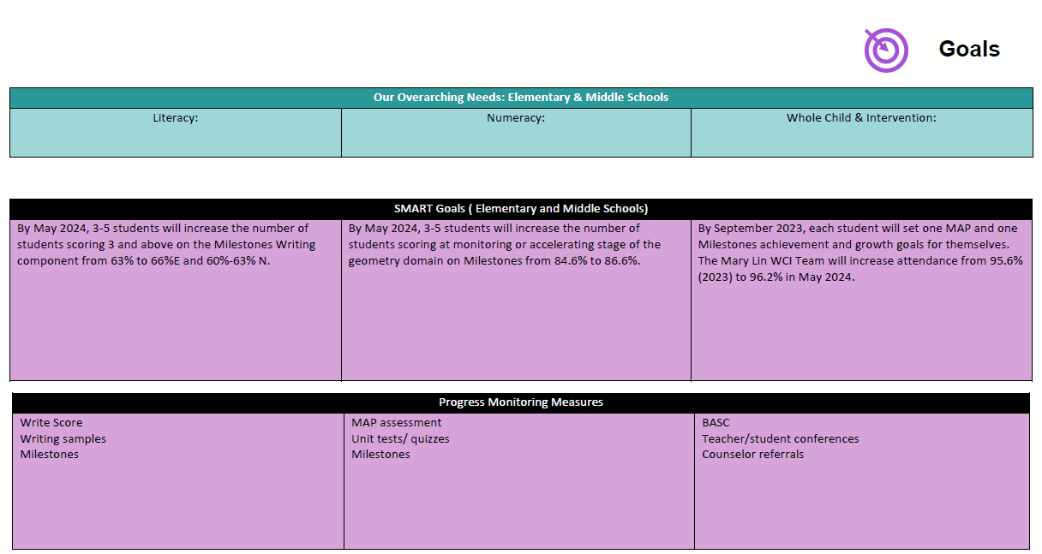

Slide 11
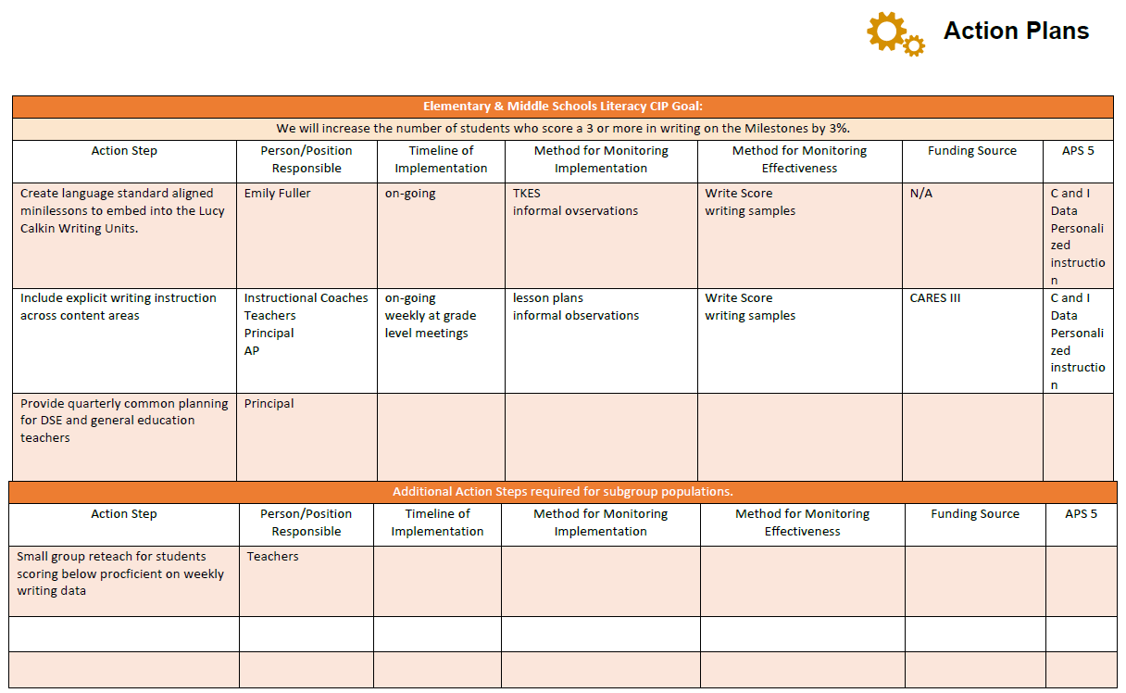

Slide 12
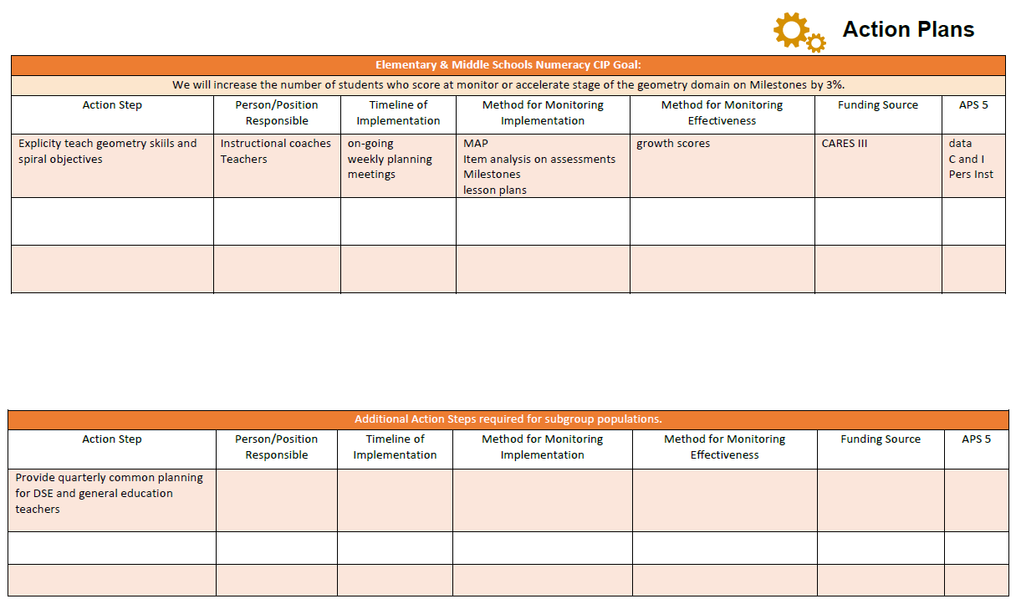

Slide 13
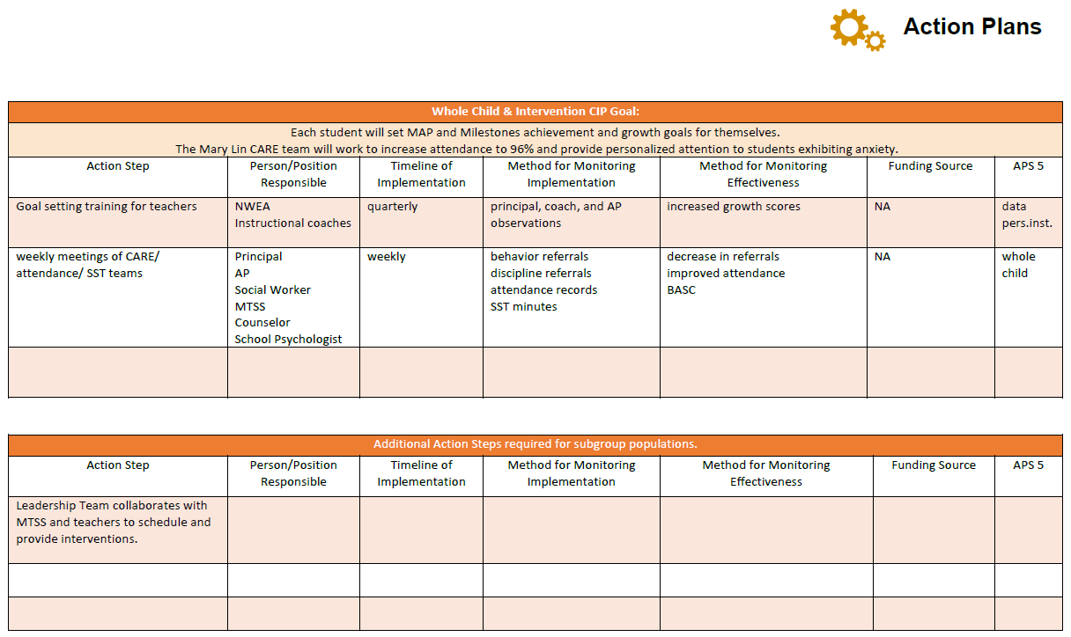

Slide 15
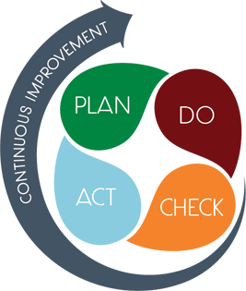
CONNECTING THE STRATEGIC PLAN & CONTINUOUS IMPROVEMENT PLAN
Priority #1:
Build teacher capability to meet the diverse social, emotional, and academic needs of students
CIP SMART GOAL
KEY INDICATOR
Priority #2:
Provide unique learning opportunities to cultivate students’ curiosity of learning.
CIP SMART GOAL
KEY INDICATOR
Priority #3:
Create collaborative school culture that embraces diverse families that comprise the Mary Lin community.
CIP SMART GOAL
KEY INDICATOR

Slide 16
DATA DISCUSSION

Slide 17
GO TEAM DISCUSSION: DATA PROTOCOL
What do you notice?
What are your wonderings?
What additional questions do you have?

Slide 18
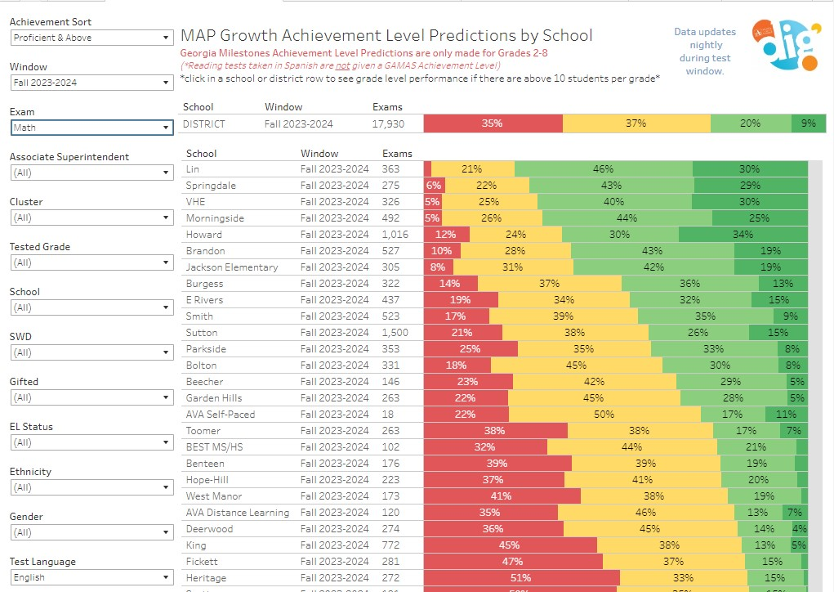
FALL 2023 MAP RESULTS
Math

Slide 19
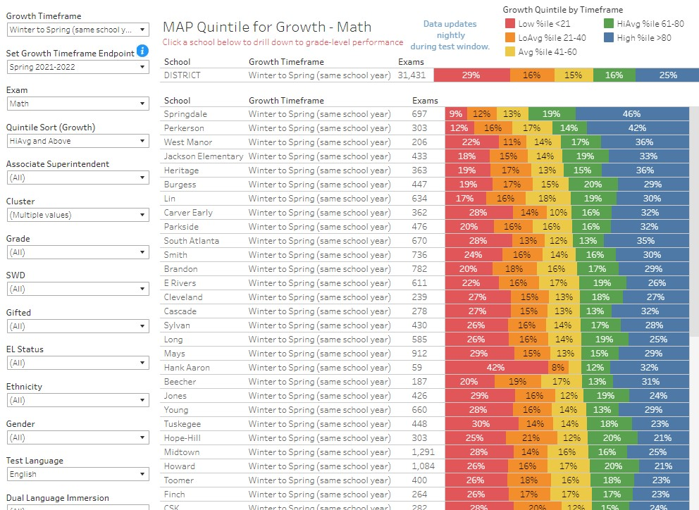
FALL 2023 MAP RESULTS
Math

Slide 20
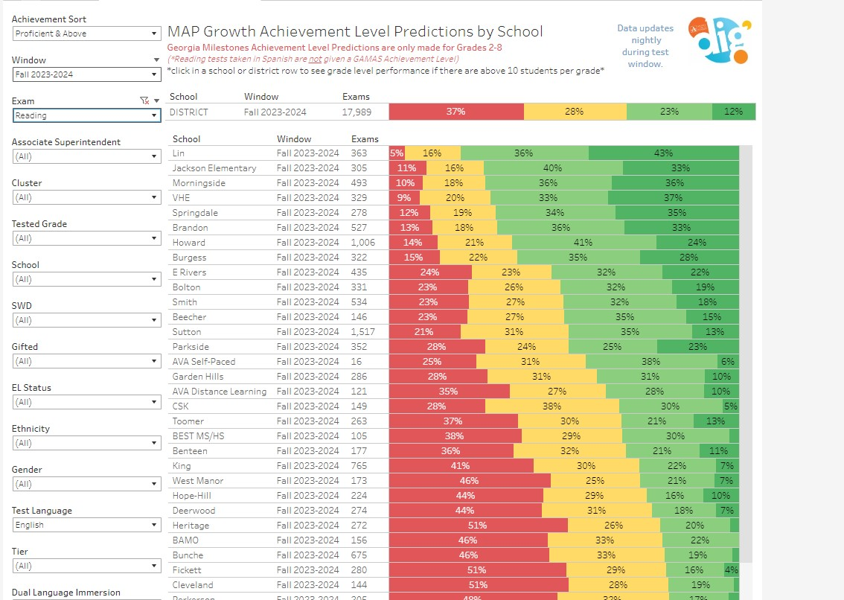
FALL 2023 MAP RESULTS
Reading

Slide 21
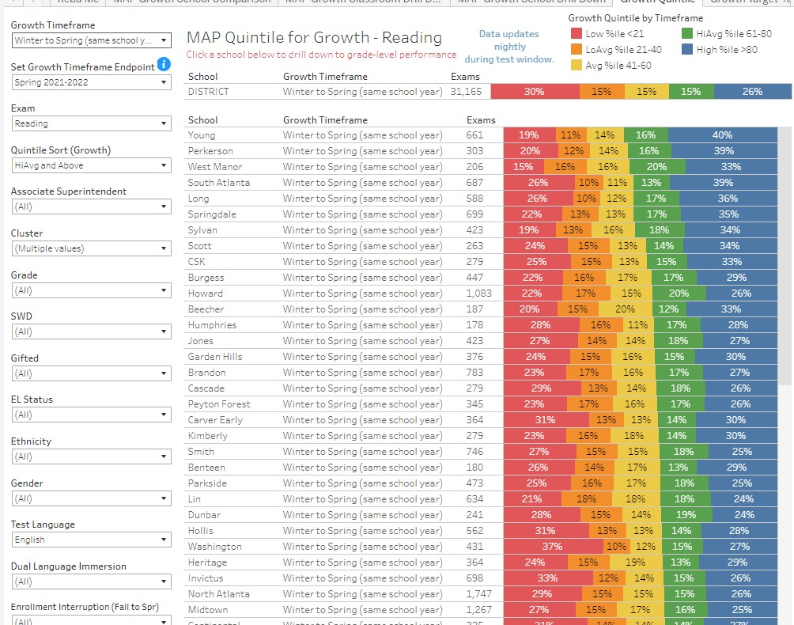
FALL 2023 MAP RESULTS
Reading

Slide 22
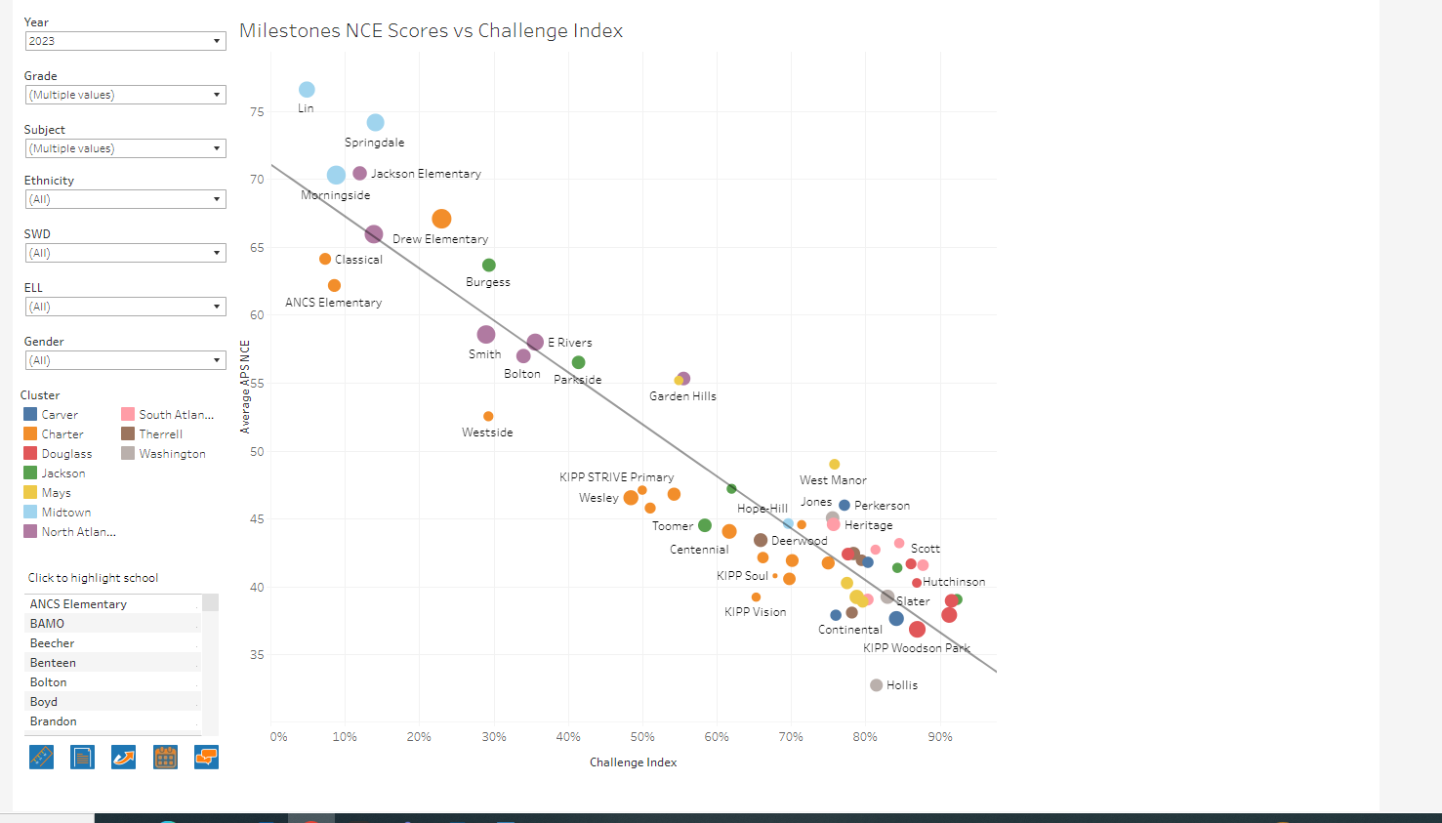
GA MILESTONES RESULTS

Slide 23
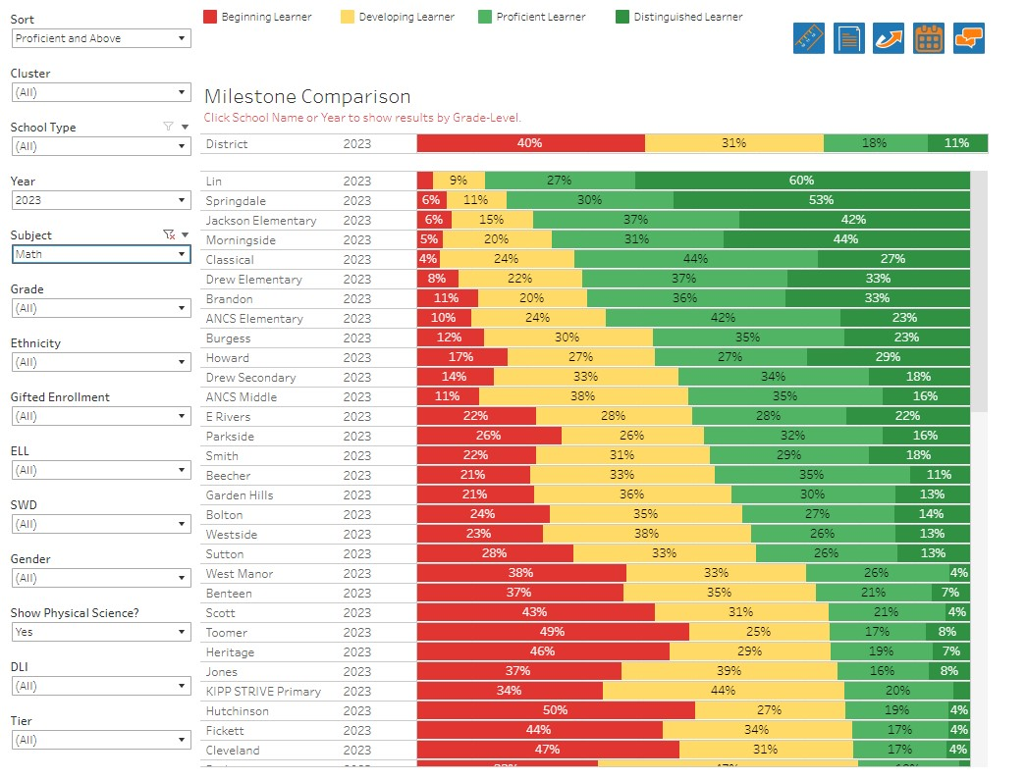
GA MILESTONES RESULTS
Math

Slide 24
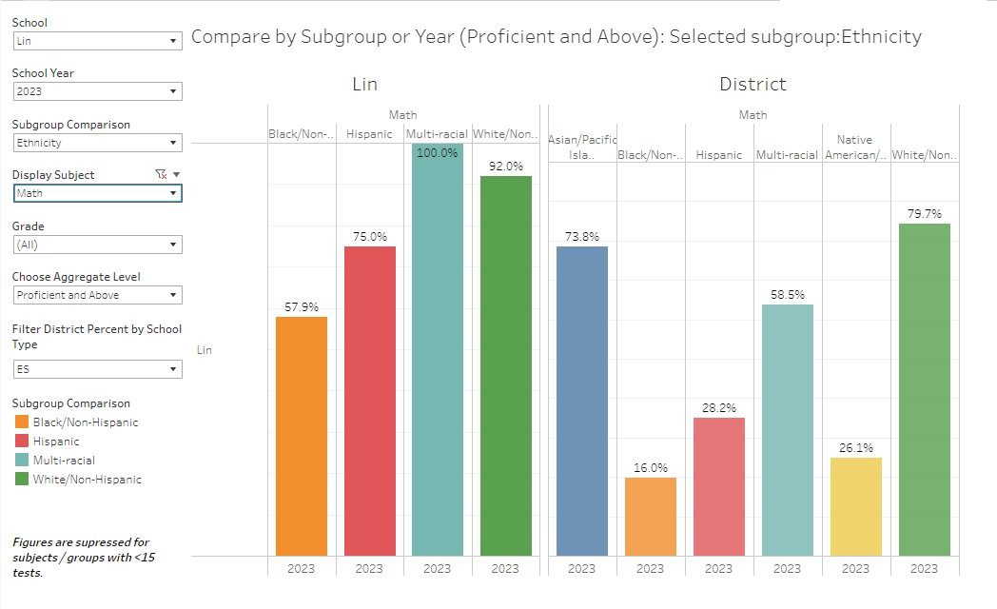
GA MILESTONES RESULTS
Math

Slide 25
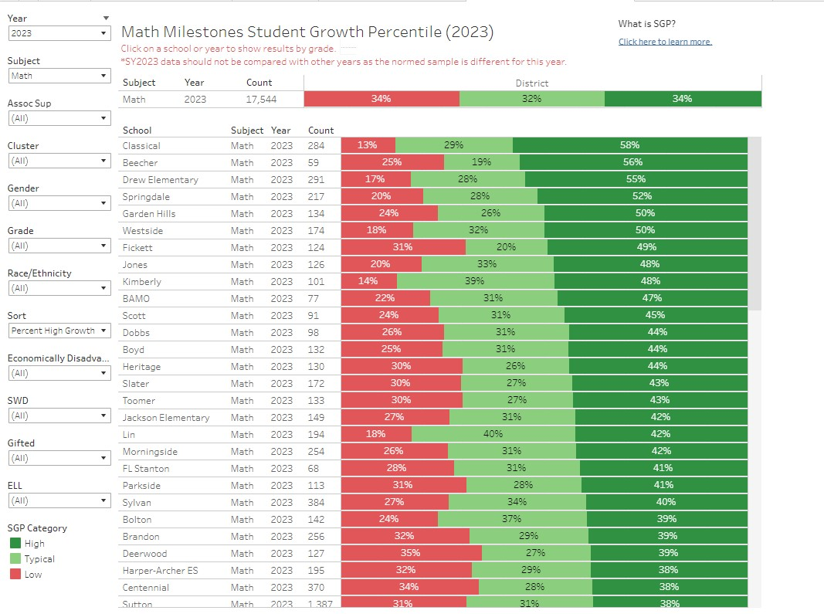
GA MILESTONES RESULTS
Math

Slide 26
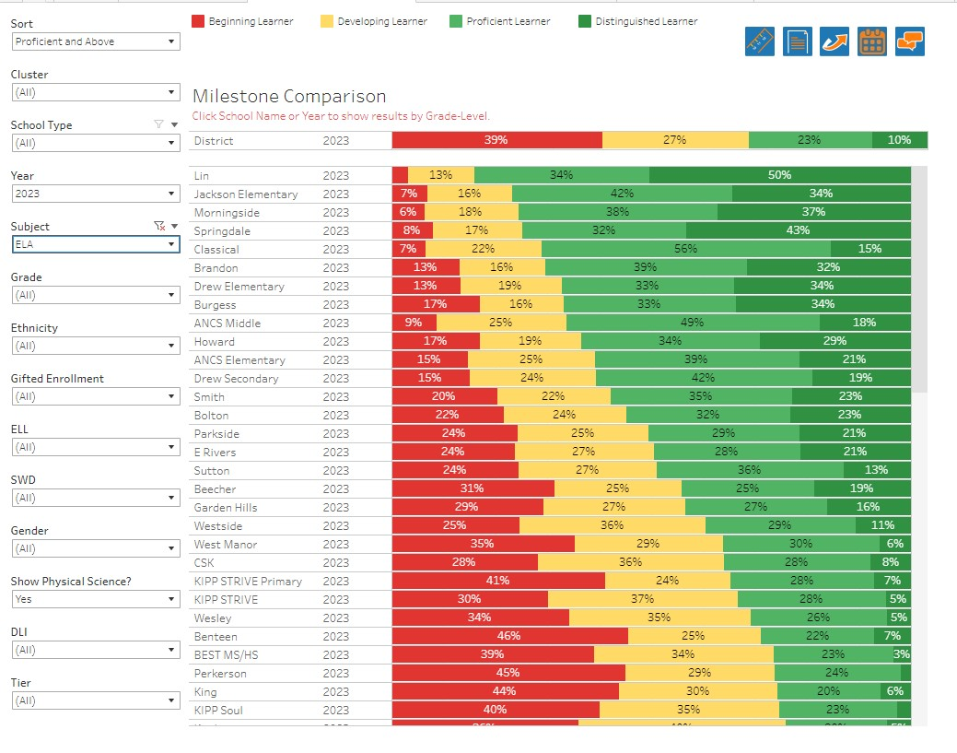
GA MILESTONES RESULTS
ELA

Slide 27
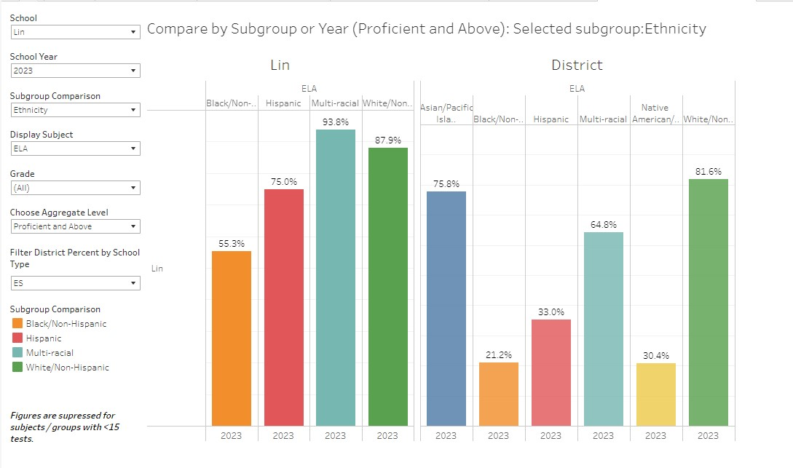
GA MILESTONES RESULTS
ELA

Slide 28
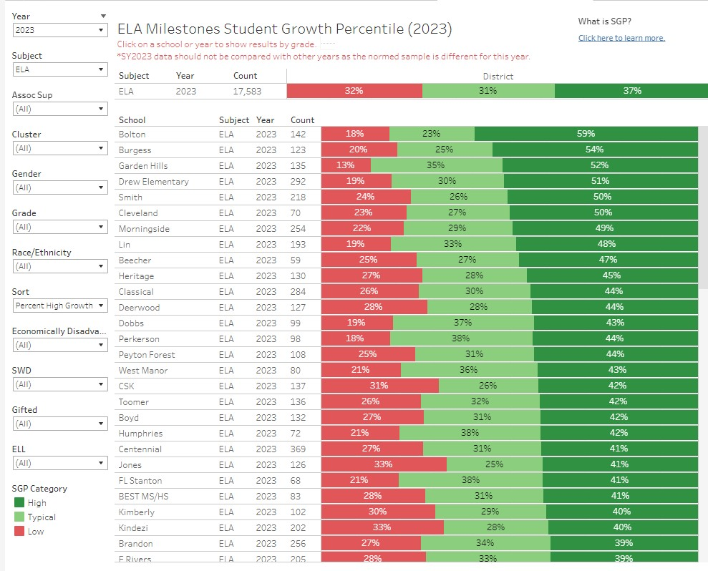
GA MILESTONES RESULTS
ELA

Slide 29
GLOWS & GROWS
GLOWS
GROWS
ARE WE ON TARGET TO SUCCESSFULLY ACCOMPLISH OUR PRIORITIES?
IMPACT

Slide 31
PRINCIPAL’S REPORT

Slide 32
ENROLLMENT
Projected Enrollment | 551
Day 14 Enrollment | 511
Difference | 40
LEVELING
Leveling is the process the District uses to adjust school budget allocations to match student enrollment.
Budget Impact | Change at Base Weight $5,193: ($207,720.00) Reserves: $45,000.00
Notes:
Principals: Based on your enrollment, please give your GO Team the information on how you plan to account for any budget changes due to leveling.

Slide 33
QUESTIONS?

Slide 34
Plan for AT LEAST 3 of your GO Team members to attend!

